Slide 1
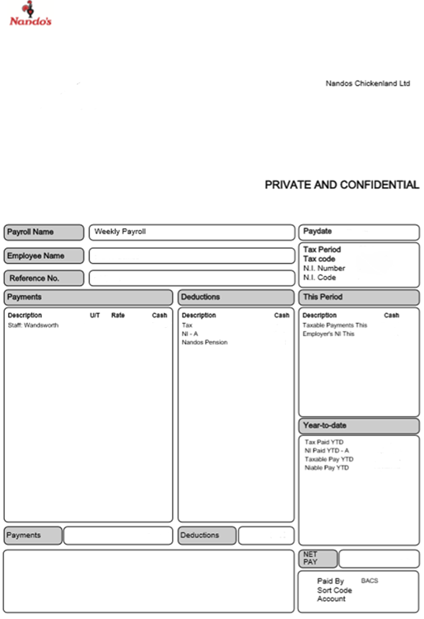

Out with the OLD and in with the NEW
Information about your old Payslip
Deductions- this will be deductions from your salary. I.E ‘Nandos Pension’, Student Loan & National Insurance
Employee Name: Your full name will appear in this box
Your National Insurance Number
Payment / Earnings: This is your salary before any deductions. Weekly paid Nandocas will have location, hourly rate and number of hours worked.
These are the payslips you are used to seeing.
All the information you see on here is also on your new payslip.
Net Pay/Amount: this will be the amount paid into your bank account

Slide 2
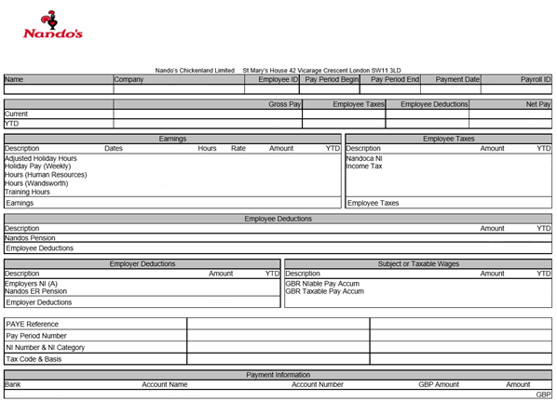
Out with the old and in with the new
Information about your NEW Workday payslip
Address
Employee Name: Your full name will appear in this box
Payment / Earnings: This is your salary before any deductions. Weekly paid Nandocas will have location, hourly rate and number of hours worked.
Your new Workday Payslip looks a little different.
Nothing to worry about here are all the things you need to know.
Deductions- this will be deductions from your salary. I.E ‘Nandos Pension’, Student Loan & National Insurance
Your National Insurance Number
Net Pay/Amount: this will be the amount paid into your bank account

